Slide 1


CONNECT BVC
Atai | Oluchi | Deepanshi |Niriya

Slide 2

revolutionizing BVC student experience

Slide 3
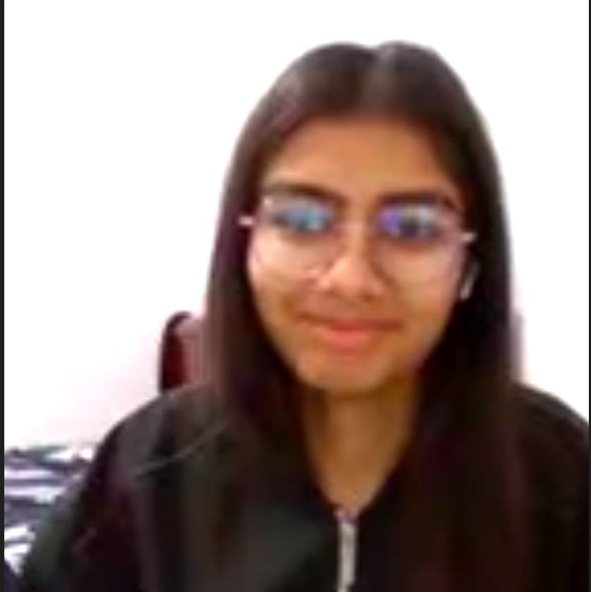
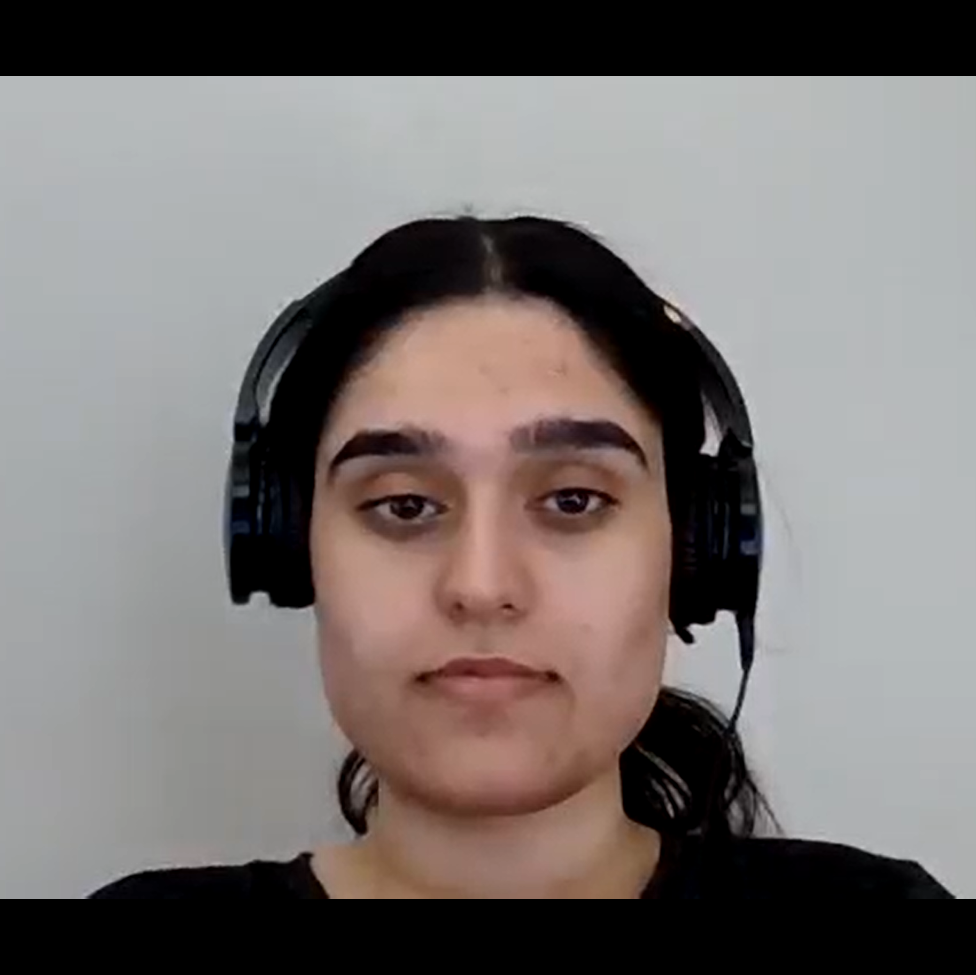


Our team
Niriya
Deepanshi
Oluchi
Atai

Slide 4
PROJECT summary
Connect BVC is a mobile app for BVC students by BVC students
Designed by 4 BVC School of Technology students,
Our goal is to revolutionize student life and experience at BVC
Features include course registration, grade tracker, course materials, discussion and engagement forums etc

Slide 5
PROJECT CHARTER
COMMITMENTS
C | O | N | N | E | C | T
COMMITTED
OPEN
NO JUDGING
NIMBLE
EFFICIENT
CORDIAL
TIMELY
MISSION
DESIRED END RESULT
collaboratively design a functional and scalable mobile app to enhance the college experience for BVC (Bow Valley College) students.
We aim to provide tools and resources supporting academic success, community engagement, and simplifying campus life.
A fully functional mobile app across all platforms.
Value addition to the BVC student community.
Features for course feedback, instructor rating, and overall learning experience evaluation.\
Access to learning materials, calendar, study session scheduling, and important date notifications.

Slide 6
APP FEATURES
Course Registration
Grade Tracker
Payment System
Discussion Forum
Student Feedback / Survey
News Feed
Assignment Submission
Course Materials
Notifications and Alerts
User Profile

Slide 7
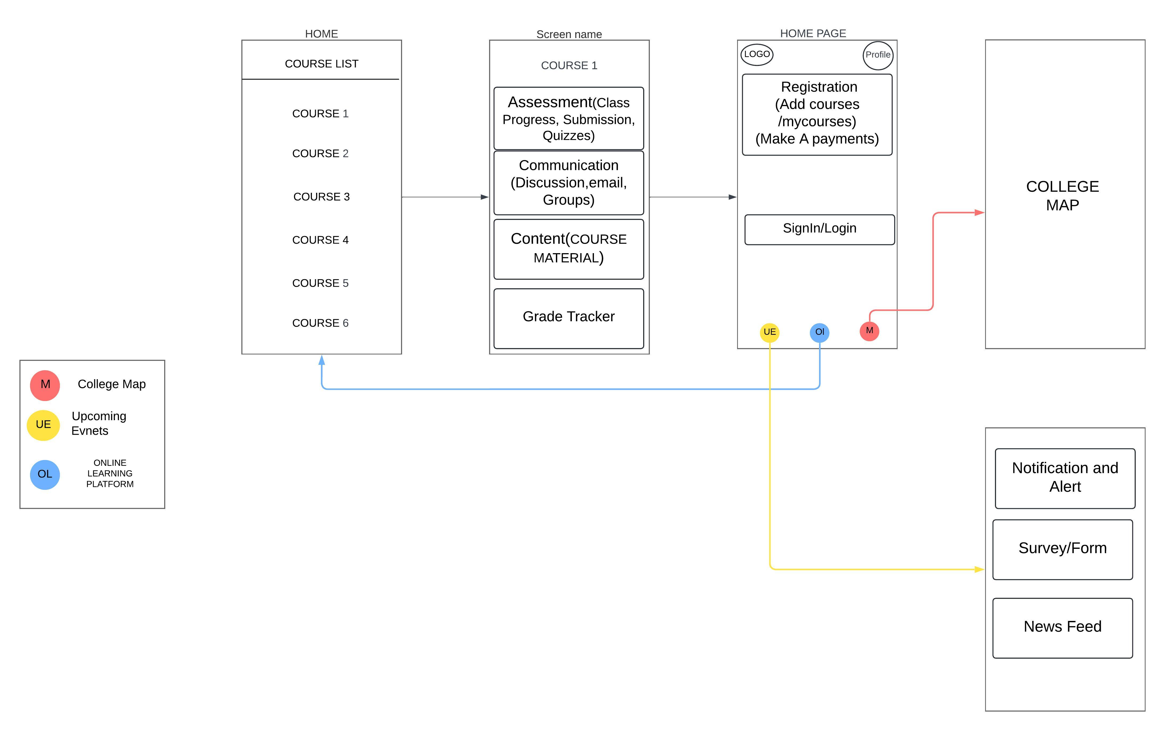
WIRE FRAME

Slide 8
PROJECT FUNDING
Grants and Scholarships
Corporate Sponsorship
Crowdfunding campaign

Slide 9
CONCLUSION
we dream of a future where every student at Bow Valley College has everything they need to succeed.
Our mobile app is a pivotal part of this vision
your support and partnership can turn this vision into reality
Let's unite and embark on this exhilarating journey towards student success, shaping a brighter future for Bow Valley College, one student at a time

Slide 10
Peer evaluation
Team Member | ​​Score #​
Atai Okokon | 5
Oluchi Ruth Osuafor-Humphrey | 5
Deepanshi | 5
Niriya | 5
Score 5 | Full Participation
Score 4 | Good Participation
​​Score 3​ | Participated
​​Score 2​ | Minimal Participation
​​Score 1​ | No Participation

